Slide 1


Powered by

Slide 2
Why did we make shinyMBA?
Simplify the way we do quality control (QC) by automating the tedious parts
upload xPONENT and/or Bio-Plex Manager (BPM) files and let the app do the heavy lifting
Expand participation in the QC process
Enables better QC communication and transparency
Expands QC capacity
Simple and flexible data analysis
Point and click interface
Flexibility to customize the QC parameters based on individual studies

Slide 3
shinyMBA Features
Visualize plate bead counts and MFI
Flag wells and whole plates with low bead counts and/or MFI
Track control performance over time
Flag plates with poor performing controls
Download merged datasets and summary tables
Download high resolution plots

Slide 4
Basic workflow
Load your xPONENT (.xlsx) and/or multi-tab BPM (.xlsx) files into the app
Indicating background and specific controls in xPONENT protocol aids user in plot generation
BPM files must have tabs for “FI”, “FI – Bkgd”, and “Bead Count” or they will not be accepted
Set QC parameters in the app’s modules
Interact with your data in the modules
Download QC outputs

Slide 5
Getting Started
Uploading your runs into the app

Slide 6
3 options for uploading your run data
Upload only your xPONENT (.csv) and/or BPM (.xlsx) instrument files
Upload only merged datasets from previous shinyMBA sessions
Use “raw_data.csv” acquired from the Downloads module
Append your xPONENT/BPM files to a merged datasets from a previous shinyMBA session

Slide 7
Upload only your xPONENT (.csv) and/or BPM (.xlsx) instrument files

Slide 8
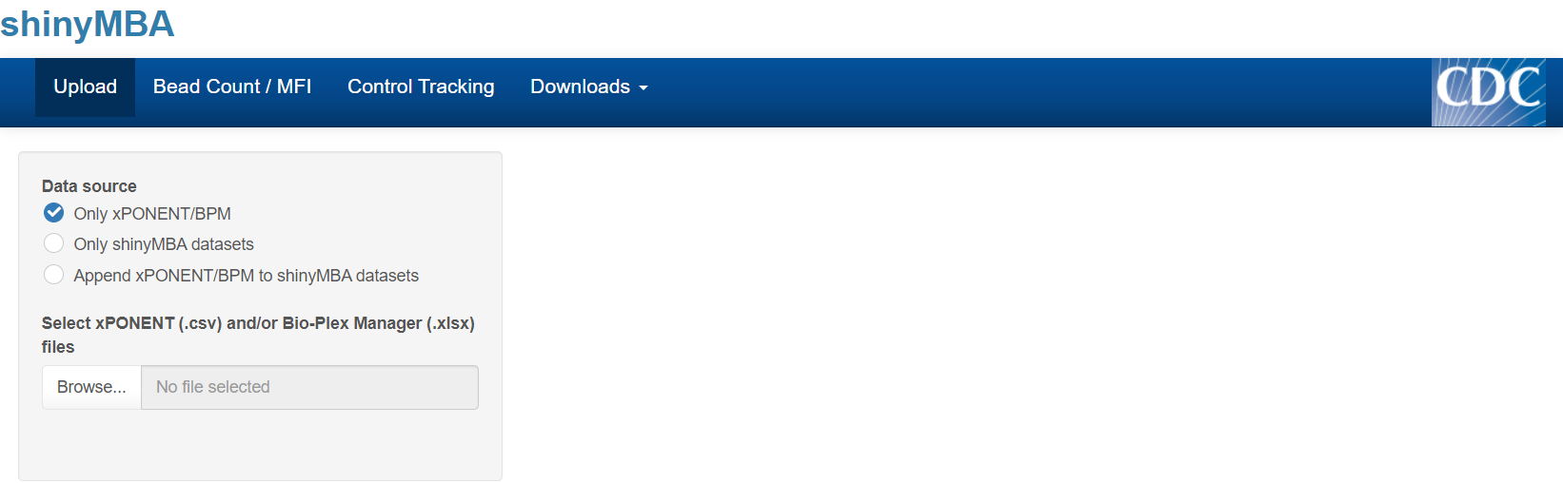
Load xPONENT (.csv) and/or BPM (.xlsx) files into the app
Click the “Upload” tab
Under “Data source”, select “Only xPONENT/BPM”
Click “Browse…” to open the file explorer

Slide 9
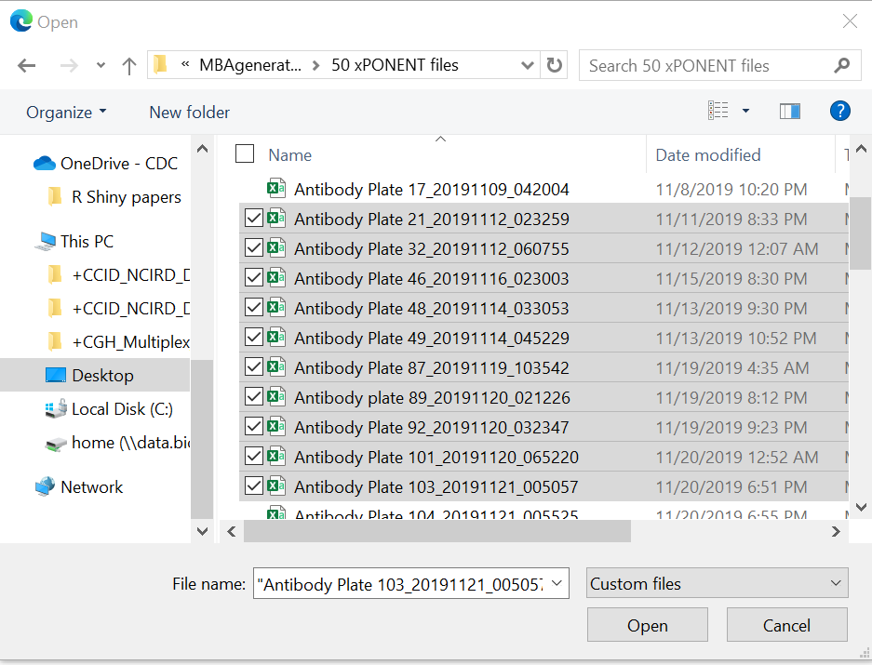
Load xPONENT (.csv) and/or BPM (.xlsx) files into the app
Click the “Upload” tab
Under “Data source”, select “Only xPONENT/BPM”
Click “Browse…” to open the file explorer
Select the xPONENT and/or BPM files you want to load (multiple can be loaded at once) and click “Open”

Slide 10
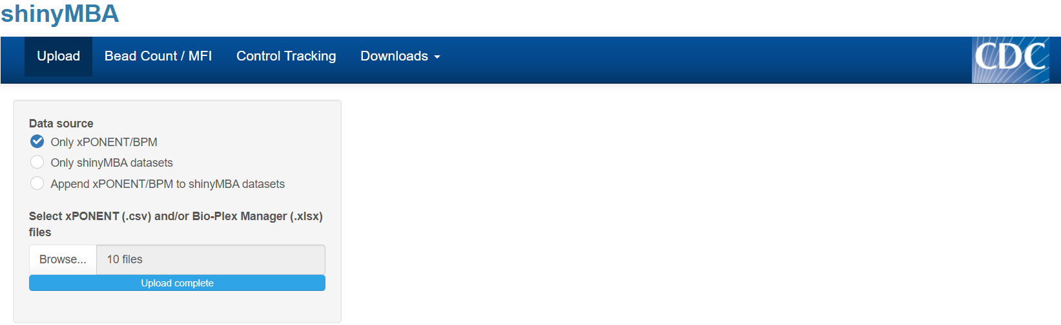
Load xPONENT (.csv) and/or BPM (.xlsx) files into the app
Click the “Upload” tab
Under “Data source”, select “Only xPONENT/BPM”
Click “Browse…” to open the file explorer
Select the xPONENT and/or BPM files you want to load (multiple can be loaded at once) and click “Open”
Wait for the progress bar to state “Upload complete”
Begin using the app!

Slide 11
Upload only merged datasets from previous shinyMBA sessions

Slide 12
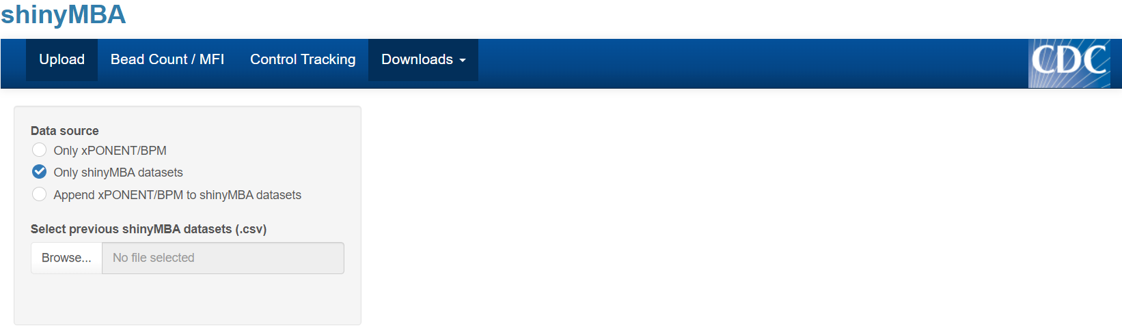
Load datasets from previous shinyMBA session
Click the “Upload” tab
Under “Data source”, select “Only shinyMBA datasets”
Click “Browse…” to open the file explorer

Slide 13
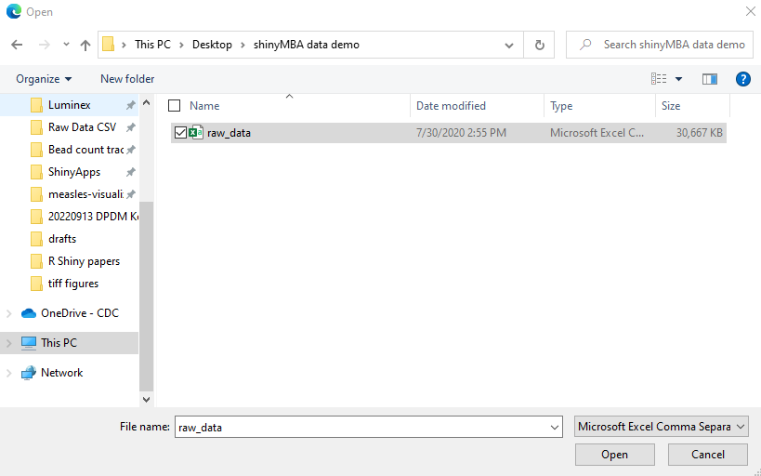
Load merged datasets from previous shinyMBA session
Click the “Upload” tab
Under “Data source”, select “Only shinyMBA datasets”
Click “Browse…” to open the file explorer
Select the merged data files you want to load (multiple can be loaded at once) and click “Open”

Slide 14
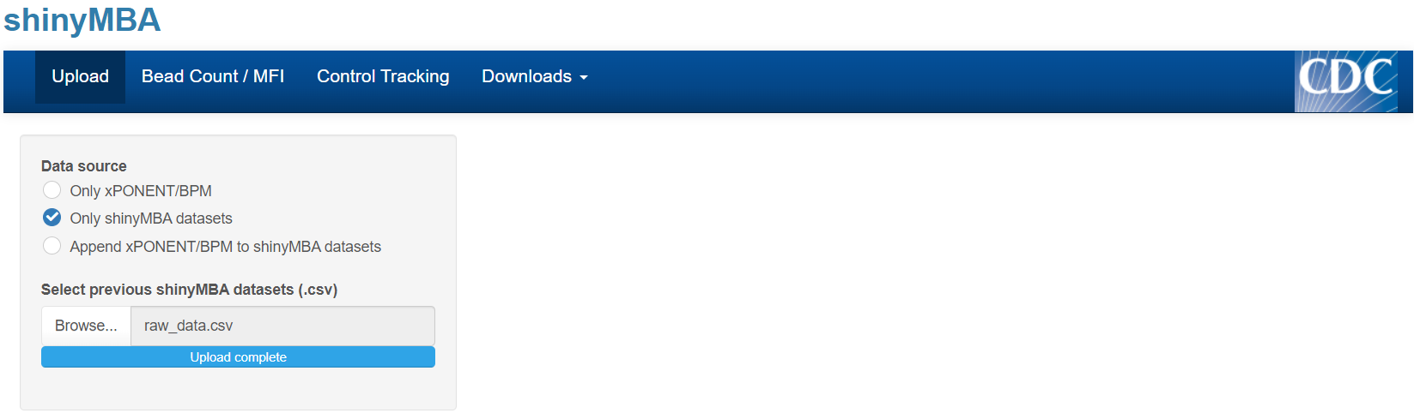
Load merged datasets from previous shinyMBA session
Click the “Upload” tab
Under “Data source”, select “Only shinyMBA datasets”
Click “Browse…” to open the file explorer
Select the merged data files you want to load (multiple can be loaded at once) and click “Open”
Wait for the progress bar to state “Upload complete”
Begin using the app!

Slide 15
Append your xPONENT/BPM files to a merged datasets from a previous shinyMBA session

Slide 16
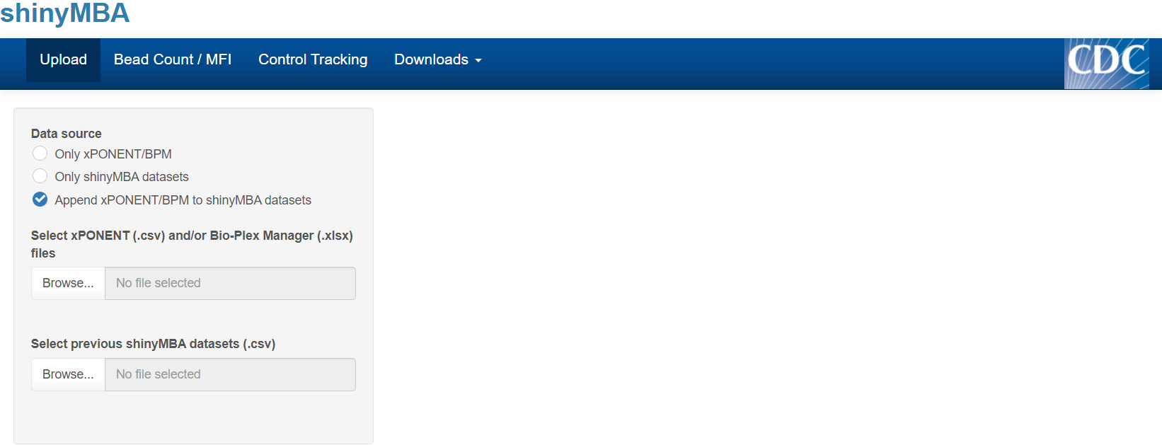
Click the “Upload” tab
Under “Data source”, select “Only xPONENT/BPM”
Load xPONENT (.csv) and/or BPM (.xlsx) files into the app
Click “Browse…” to open the file explorer

Slide 17
Click the “Upload” tab
Under “Data source”, select “Only xPONENT/BPM”
Load xPONENT (.csv) and/or BPM (.xlsx) files into the app
Click “Browse…” to open the file explorer
Select the xPONENT and/or BPM files you want to load (multiple can be loaded at once) and click “Open”

Slide 18
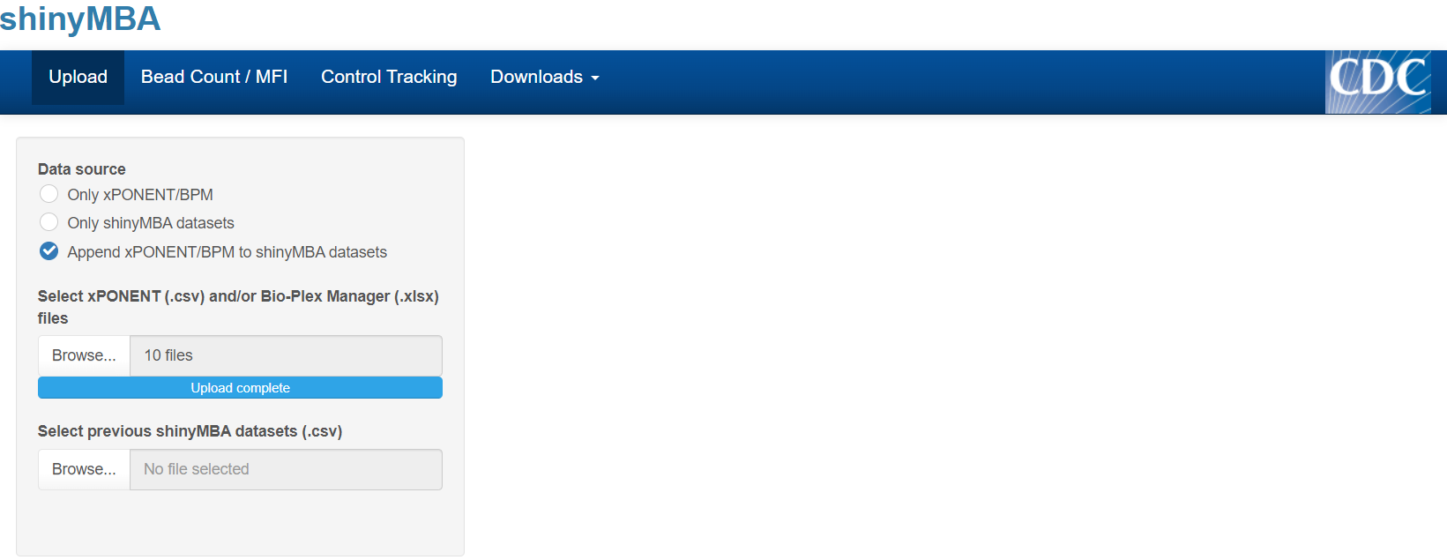
Click the “Upload” tab
Under “Data source”, select “Only xPONENT/BPM”
Load xPONENT (.csv) and/or BPM (.xlsx) files into the app
Click “Browse…” to open the file explorer
Select the xPONENT and/or BPM files you want to load (multiple can be loaded at once) and click “Open”
Load merged datasets from previous shinyMBA session
Click “Browse…” to open the file explorer

Slide 19
Click the “Upload” tab
Under “Data source”, select “Only xPONENT/BPM”
Load xPONENT (.csv) and/or BPM (.xlsx) files into the app
Click “Browse…” to open the file explorer
Select the xPONENT and/or BPM files you want to load (multiple can be loaded at once) and click “Open”
Load merged datasets from previous shinyMBA session
Click “Browse…” to open the file explorer
Select the merged data files you want to load (multiple can be loaded at once) and click “Open”

Slide 20
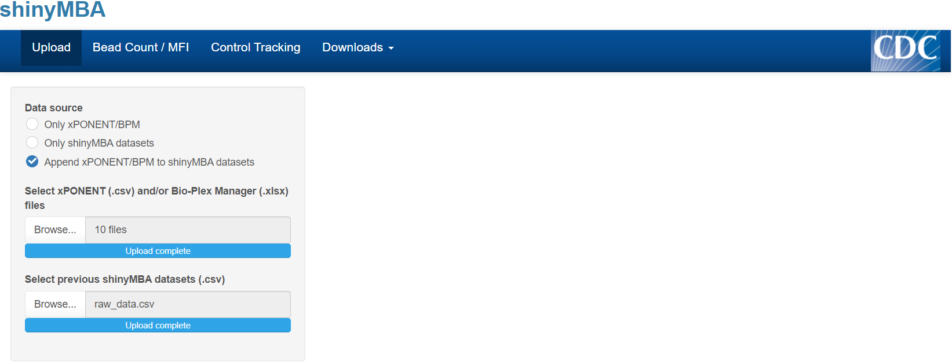
Click the “Upload” tab
Under “Data source”, select “Only xPONENT/BPM”
Load xPONENT (.csv) and/or BPM (.xlsx) files into the app
Click “Browse…” to open the file explorer
Select the xPONENT and/or BPM files you want to load (multiple can be loaded at once) and click “Open”
Load merged datasets from previous shinyMBA session
Click “Browse…” to open the file explorer
Select the merged data files you want to load (multiple can be loaded at once) and click “Open”
Wait for the progress bars to state “Upload complete”
Begin using the app!

Slide 21
Bead Count QC

Slide 22
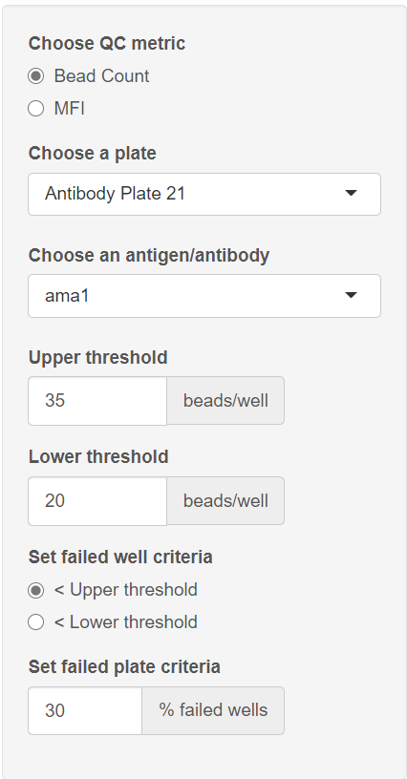
Bead Count QC: setting parameters
Click the “Bead Count / MFI” tab
Under “Choose QC metric” select “Bead Count”
Under “Choose a plate” and “Choose an antigen/antibody”, select which batch and antigen/antibody combination you’d like the app to display.
Inform the app of your bead count upper and lower thresholds
Set how the app determines failed wells
Bead counts under the upper threshold or under the lower threshold
Set how the app determines failed plates
% of wells with bead counts under the upper or lower threshold

Slide 23
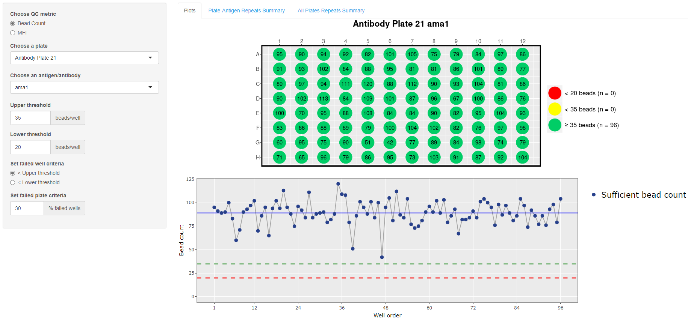

Slide 24
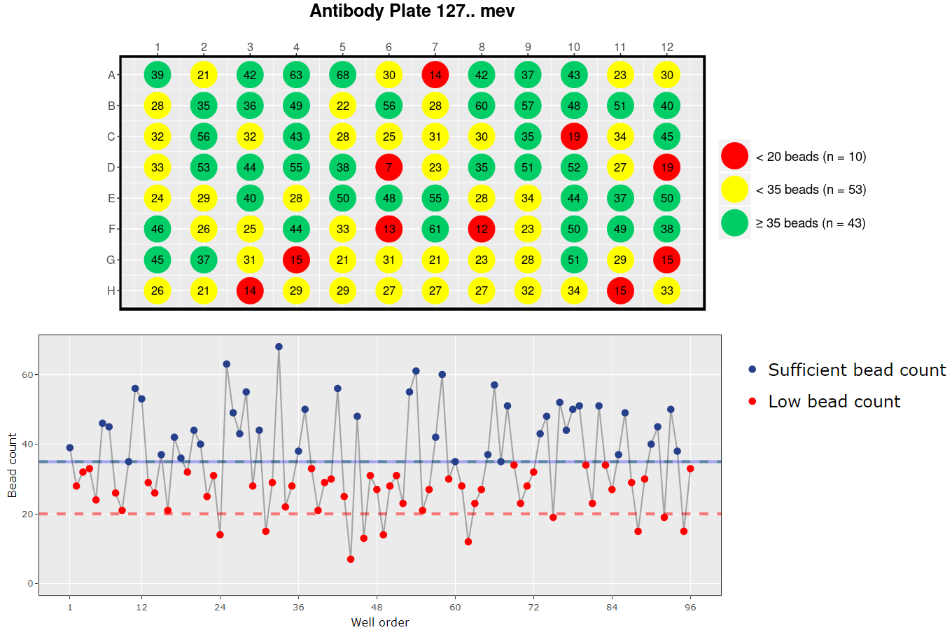
Problematic bead count example

Slide 25
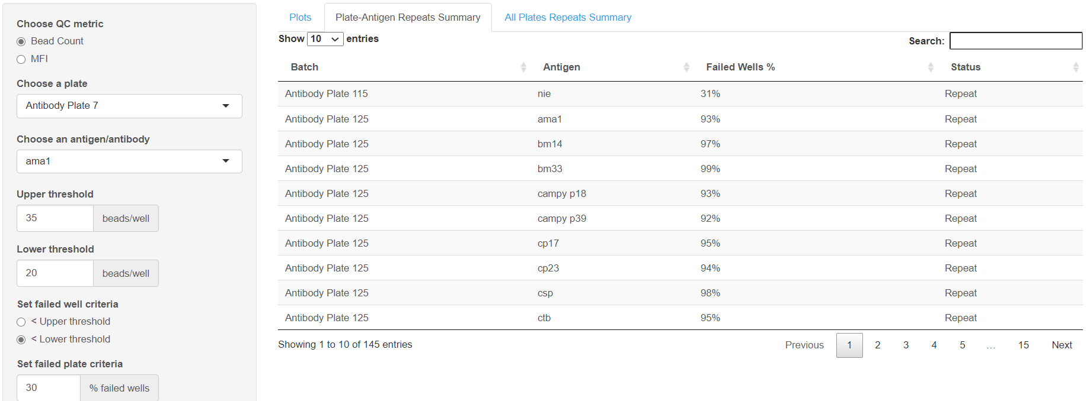
“Plate-Antigen Repeats Summary” tab contains an interactive data table of failed antigens for each batch.

Slide 26
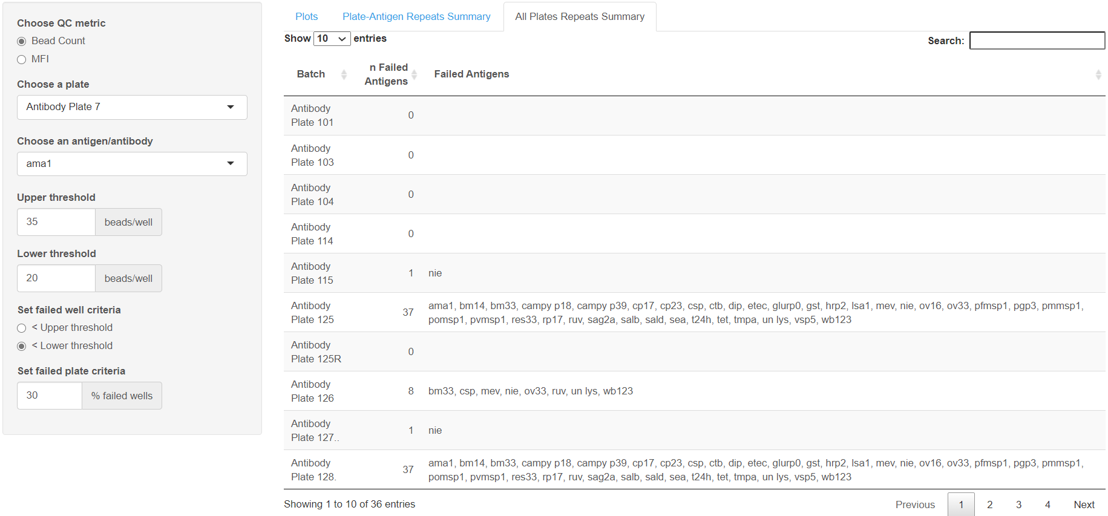
“All Plates Repeats Summary” tab contains a condensed interactive data table of failed antigens for each batch.

Slide 27
MFI QC

Slide 28
MFI QC
Helps to identify patterns of low MFI
Several factors may contribute to low MFI
missing secondary antibody
insufficient flushing with bleach prime

Slide 29
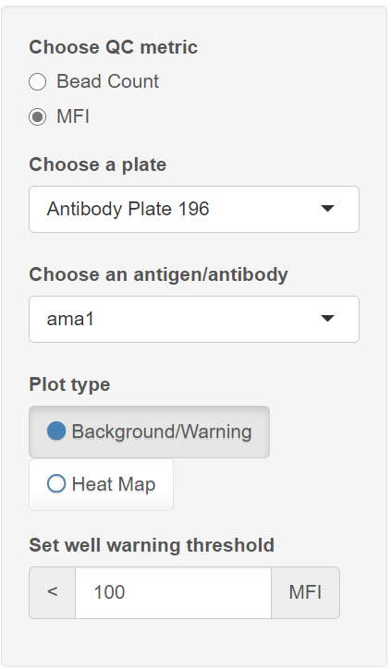
MFI QC: setting parameters
Click the “Bead Count / MFI” tab
Under “Choose QC metric” select “MFI”
Under “Choose a plate” and “Choose an antigen/antibody”, select which batch and antigen/antibody combination you’d like the app to display.
Choose which plot to display
Set the MFI warning threshold
Any wells with MFI under this value are flagged yellow

Slide 30
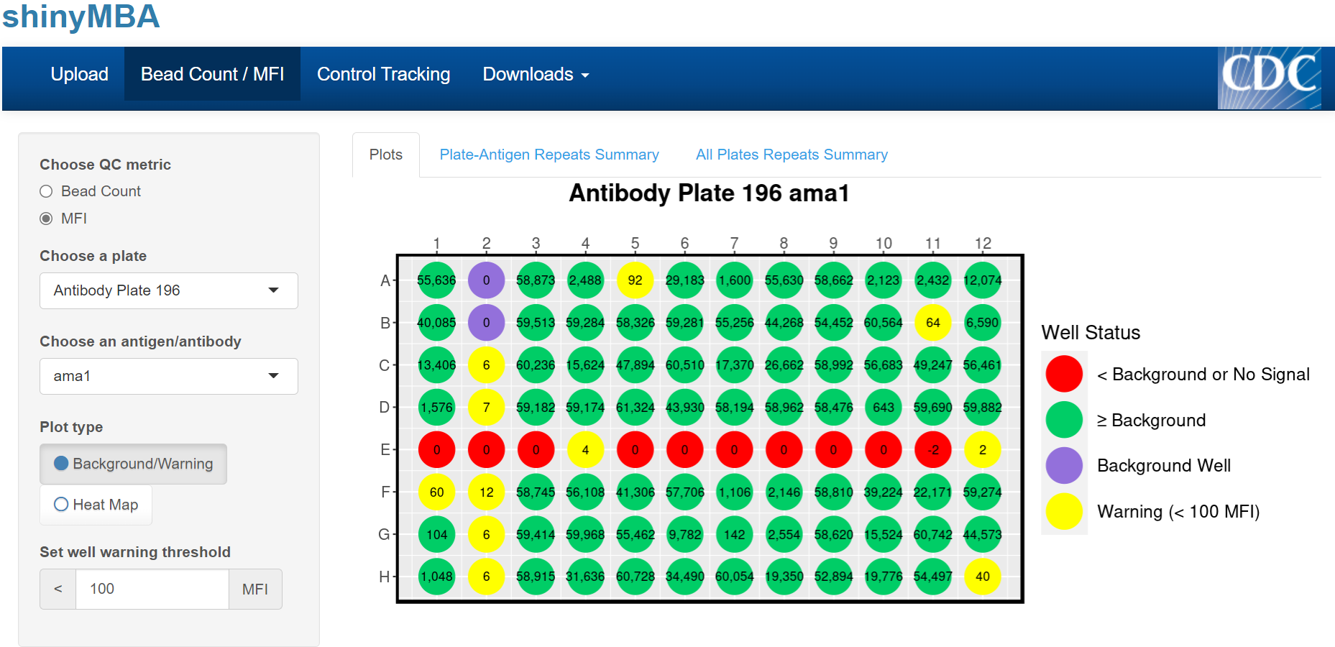
Suspicious
“Plots” tab displays a single 96-well plate plot with four color groups:
PURPLE: background well(s)
RED: MFI ≤ background MFI
YELLOW: MFI > background MFI, but < MFI warning threshold
GREEN: MFI > MFI warning threshold
“Plate-Antigen Repeats Summary” and “All Plates Repeats Summary” tabs do not display anything for MFI

Slide 31
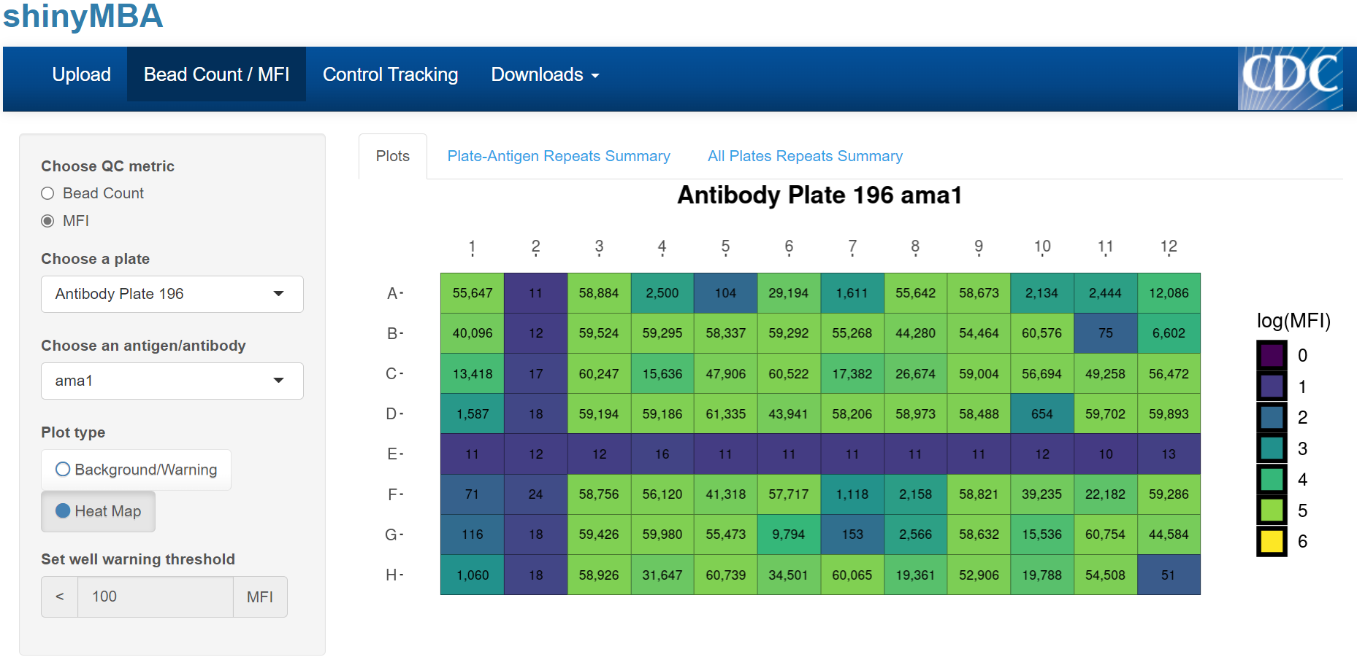
“Heat Map” displays a single 96-well plate plot with a color scale for log-transformed MFI and text displays for MFI.
MFI warning threshold is not applicable for this plot.
“Plate-Antigen Repeats Summary” and “All Plates Repeats Summary” tabs do not display anything for MFI.

Slide 32
Control Tracking
(xPONENT/BPM data source)

Slide 33
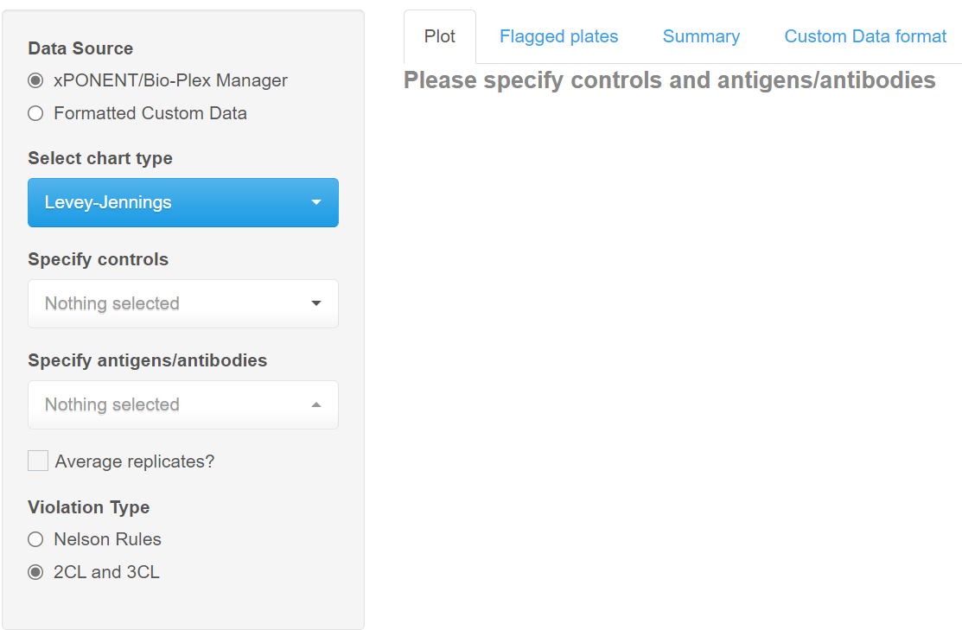
Control Tracking: xPONENT/BPM data
Click the “Control Tracking” tab
Under “Data Source” select “xPONENT/Bio-Plex Manager” to begin loading your data
Data may take several minutes to load

Slide 34
Control Tracking: xPONENT/BPM data
Click the “Control Tracking” tab
Under “Data Source” select “xPONENT/Bio-Plex Manager” to begin loading your data
This may take several minutes
Under “Select chart type”, select which process control chart you want to use.
Levey-Jennings, Shewhart, or Moving Range

Slide 35
Control Tracking: xPONENT/BPM data
Click the “Control Tracking” tab
Under “Data Source” select “xPONENT/Bio-Plex Manager” to begin loading your data
This may take several minutes
Under “Select chart type”, select which process control chart you want to use
Levey-Jennings, Shewhart, or Moving Range.
Under “Specify your controls” and “Specify antigens/antibodies”, select the sample ID’s that correspond to your controls and which antigens/antibodies your controls are relevant for

Slide 36
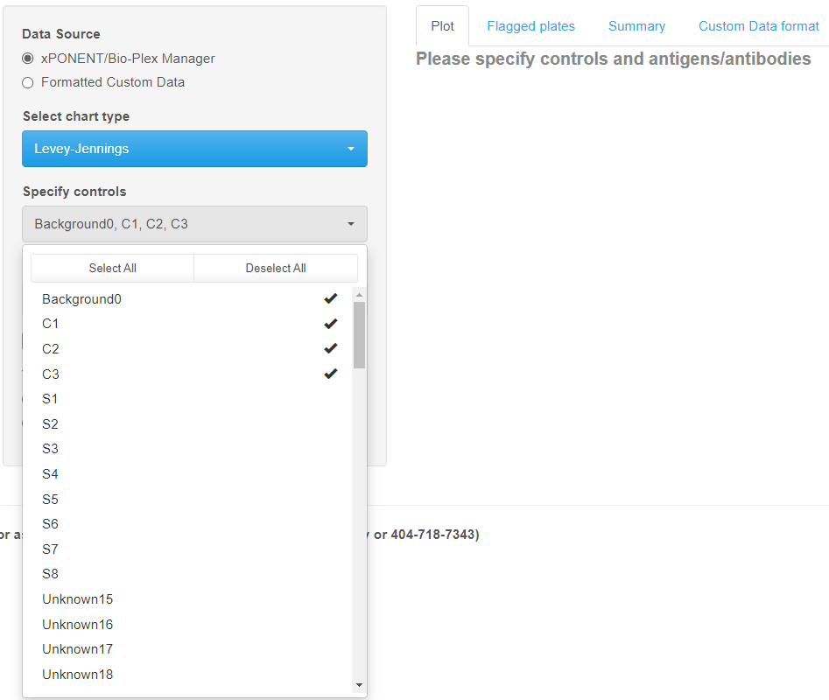
Control Tracking: xPONENT/BPM data
Click the “Control Tracking” tab
Under “Data Source” select “xPONENT/Bio-Plex Manager” to begin loading your data
This may take several minutes
Under “Select chart type”, select which process control chart you want to use
Levey-Jennings, Shewhart, or Moving Range.
Under “Specify your controls” and “Specify antigens/antibodies”, select the sample ID’s that correspond to your controls and which antigens/antibodies your controls are relevant for

Slide 37
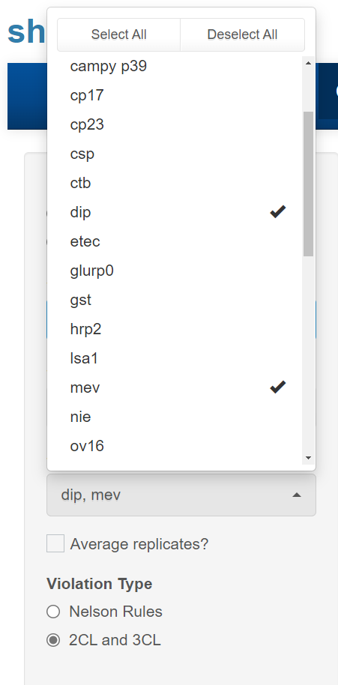
Control Tracking: xPONENT/BPM data
Click the “Control Tracking” tab
Under “Data Source” select “xPONENT/Bio-Plex Manager” to begin loading your data
This may take several minutes
Under “Select chart type”, select which process control chart you want to use
Levey-Jennings, Shewhart, or Moving Range.
Under “Specify your controls” and “Specify antigens/antibodies”, select the sample ID’s that correspond to your controls and which antigens/antibodies your controls are relevant for

Slide 38
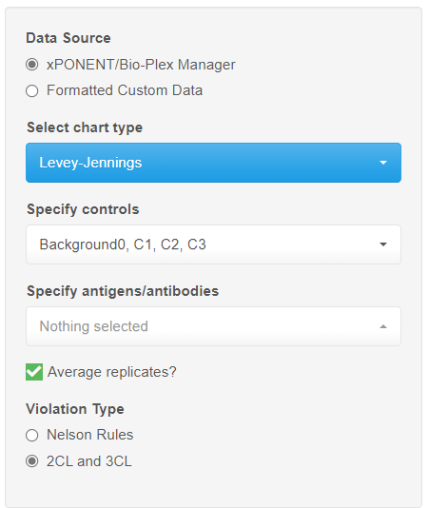
Control Tracking: xPONENT/BPM data
Click the “Control Tracking” tab
Under “Data Source” select “xPONENT/Bio-Plex Manager” to begin loading your data
This may take several minutes
Under “Select chart type”, select which process control chart you want to use
Levey-Jennings, Shewhart, or Moving Range.
Under “Specify your controls” and “Specify antigens/antibodies”, select the sample ID’s that correspond to your controls and which antigens/antibodies your controls are relevant for
Check “Average replicates?” if control replicates for each plate should be averaged before conducting LJ analyses
Under “Violation Type”, choose the criteria for out of control data points
Nelson Rules: set of 8 rules commonly used in control charts
2CL and 3CL: flags points falling outside of the 2σ or 3σ confidence limits

Slide 39
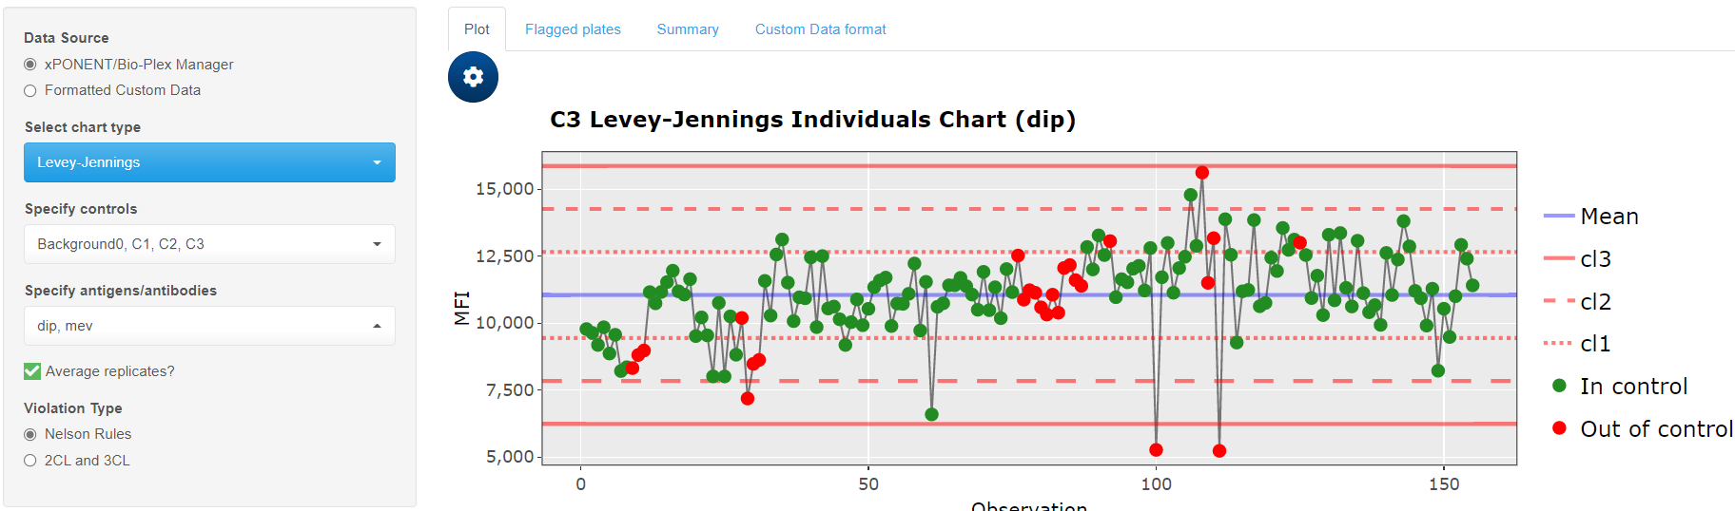
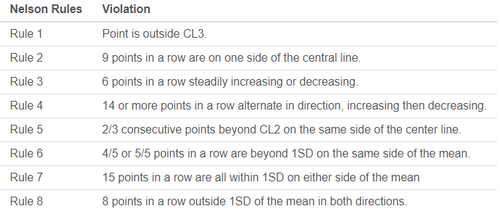

Slide 40
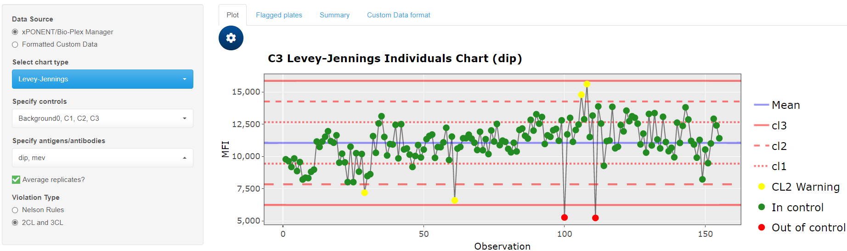

Slide 41
Change which plot is displayed here

Slide 42
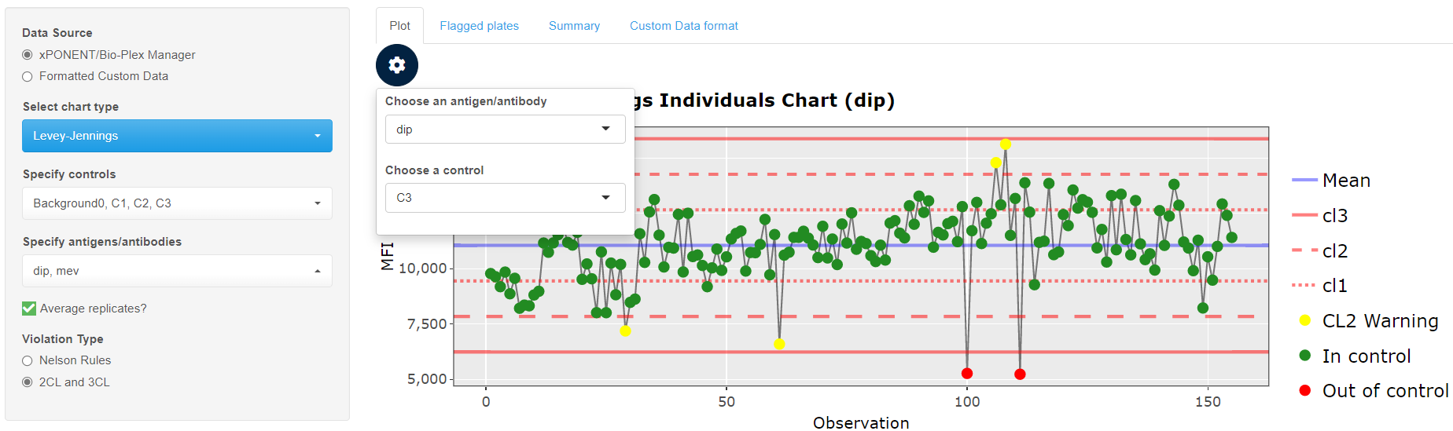

Slide 43
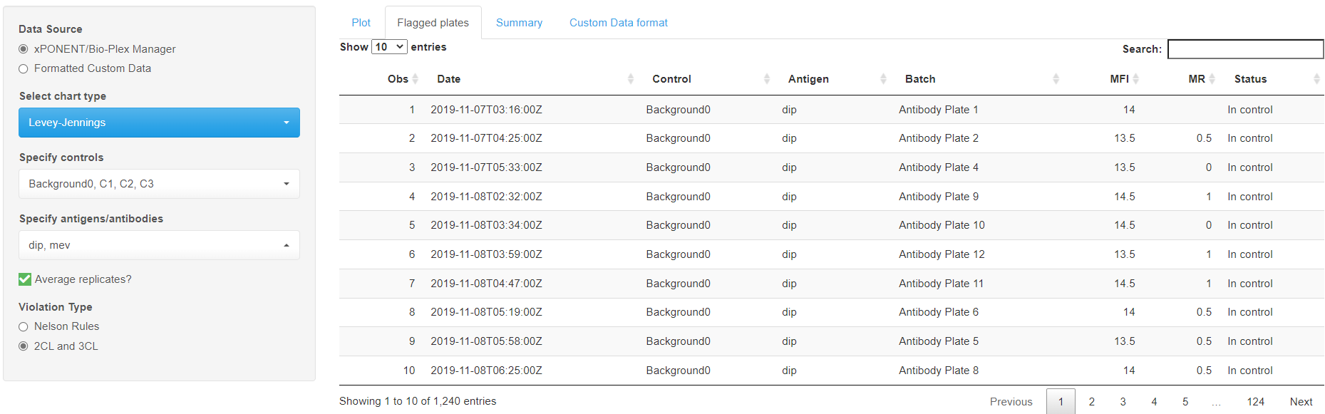
“Flagged Plates” tab contains a list of out of control data points
Shows out of control points for every antigen/antibody

Slide 44
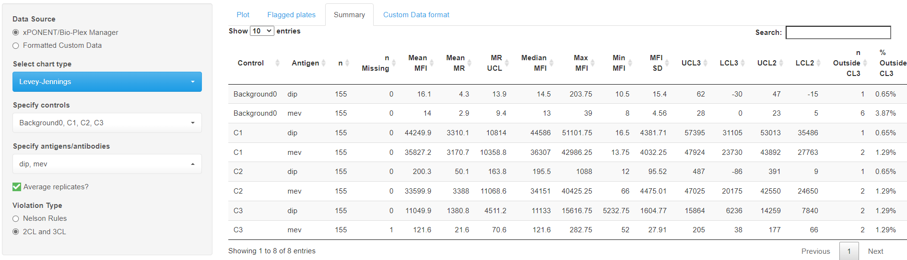
“Summary” tab contains a descriptive statistical summary table for every control and antigen/antibody combination

Slide 45
Control Tracking
(Custom data source)

Slide 46
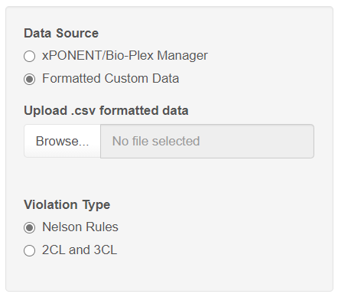
Control Tracking: Custom Data
Click the “Control Tracking” tab
Under “Data Source” select “Formatted Custom Data”

Slide 47
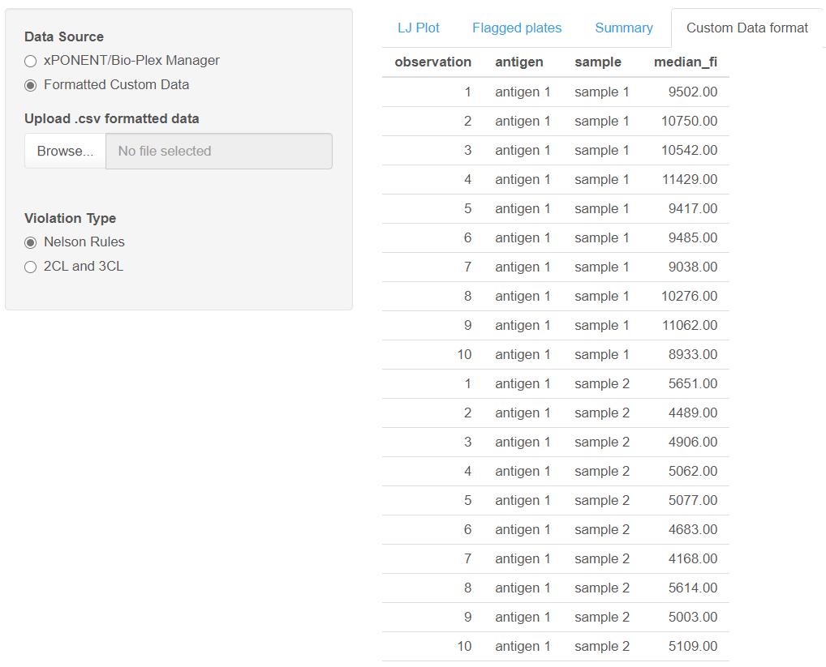
Control Tracking: Custom Data
Click the “Control Tracking” tab
Under “Data Source” select “Formatted Custom Data”
Ensure that your data is formatted correctly
An example of the proper format can be viewed under the “Custom Data format” tab.
Must be a four column .csv with variable names in the first row

Slide 48
Downloadable template

Slide 49
Control Tracking: Custom Data
Click the “Control Tracking” tab
Under “Data Source” select “Formatted Custom Data”
Ensure that your data is formatted correctly
An example of the proper format can be viewed under the “Custom Data format” tab.
Must be a four column .csv with variable names in the first row
Click “Browse…” to open the file explorer

Slide 50
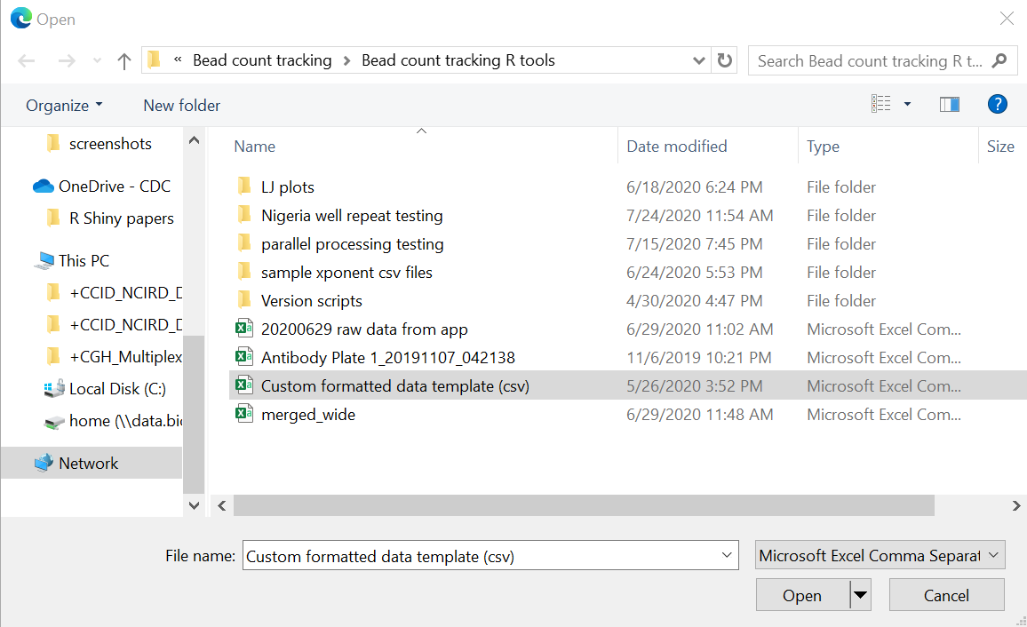
Control Tracking: Custom Data
Click the “Control Tracking” tab
Under “Data Source” select “Formatted Custom Data”
Ensure that your data is formatted correctly
An example of the proper format can be viewed under the “Custom Data format” tab.
Must be a four column .csv with variable names in the first row
Click “Browse…” to open the file explorer
Select your custom formatted .csv file and click “Open”

Slide 51
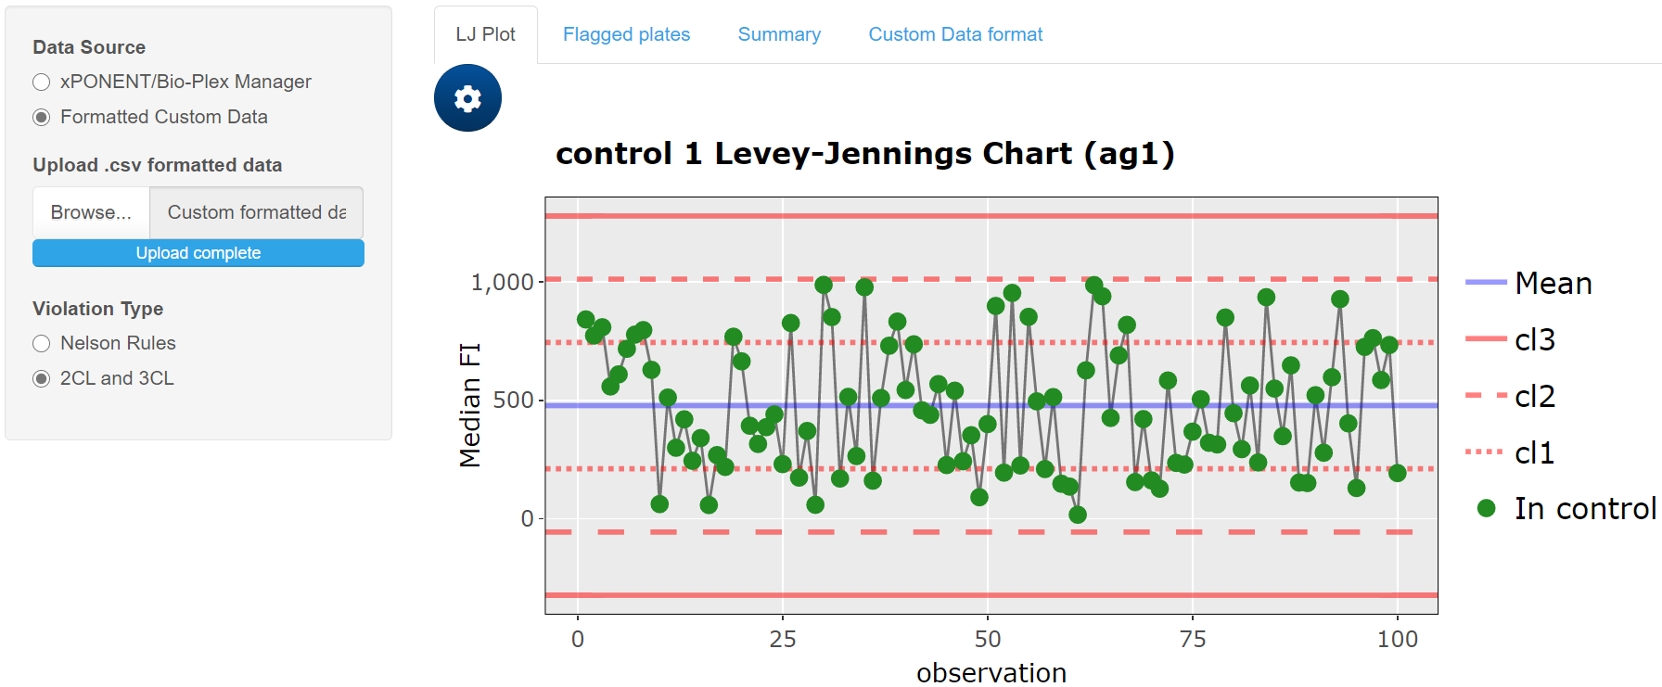
Same features are available for both xPONENT/BPM and custom formatted data.

Slide 52
Downloading Output

Slide 53
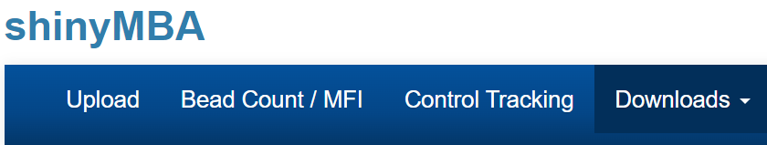
Make sure you have set all the parameters in the “Bead Count/MFI” and “Control Tracking” modules before downloading anything!

Slide 54
Downloading Output
Click the “Downloads” tab

Slide 55
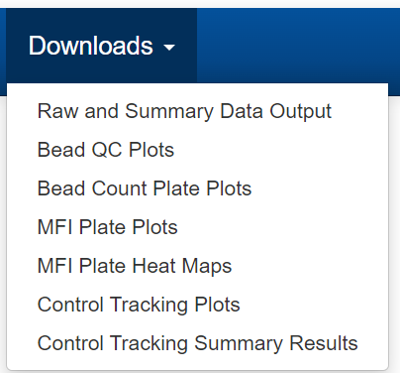
Downloading Output
Click the “Downloads” tab
From the drop-down menu, select which output you want to download

Slide 56
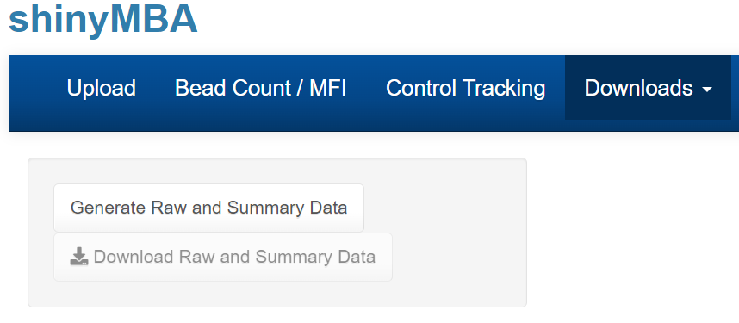
Downloading Output
Click the “Downloads” tab
From the drop-down menu, select which output you want to download.
Click the “generate” button to initiate the download

Slide 57
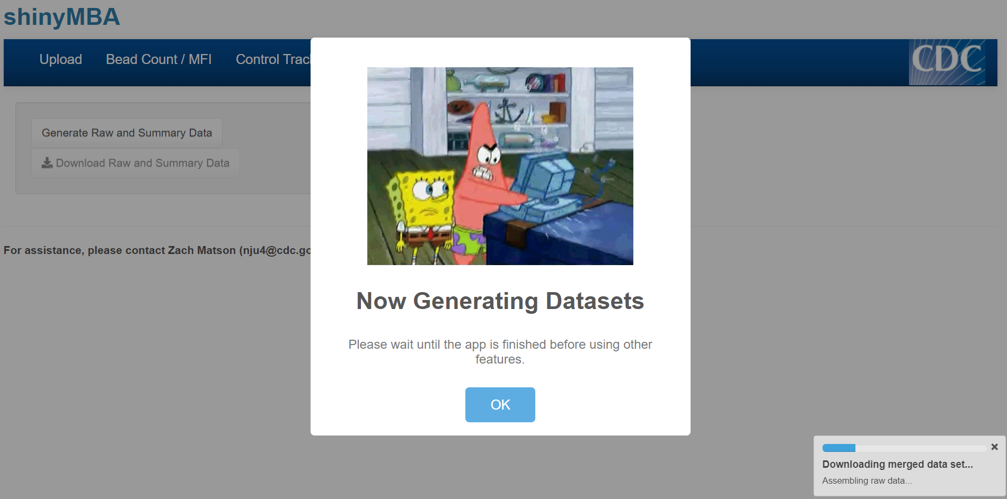
Downloading Output
Click the “Downloads” tab
From the drop-down menu, select which output you want to download.
Click the “generate” button to initiate the download
A window and progress bar will appear. Wait until a confirmation window appears before using other part of the app.

Slide 58
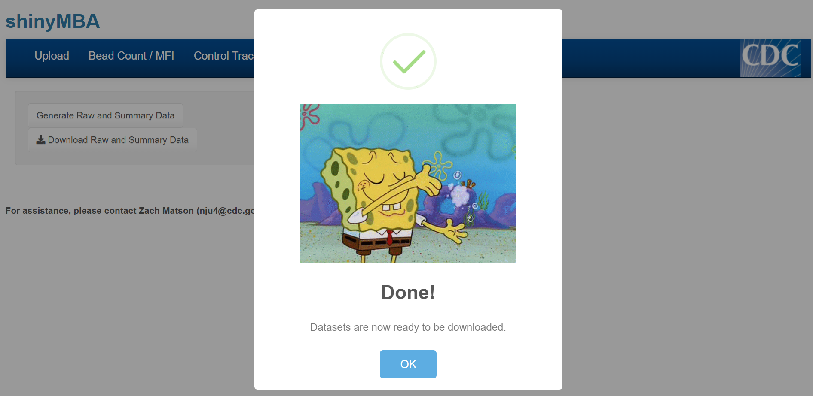
Downloading Output
Click the “Downloads” tab
From the drop-down menu, select which output you want to download.
Click the “generate” button to initiate the download
A window and progress bar will appear. Wait until a confirmation window appears before using other part of the app.

Slide 59
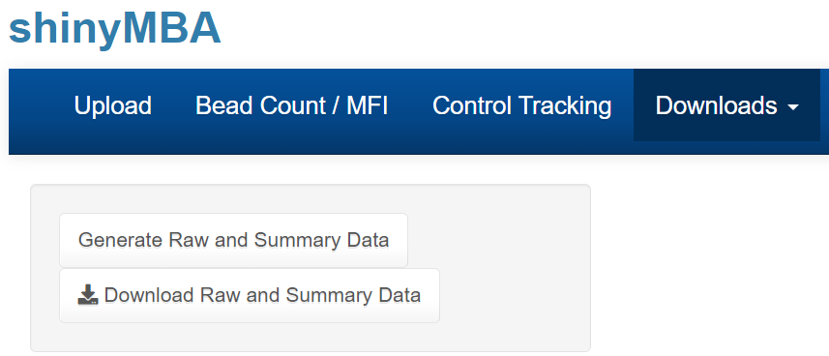
Downloading Output
Click the “Downloads” tab
From the drop-down menu, select which output you want to download.
Click the “generate” button to initiate the download
A window and progress bar will appear. Wait until a confirmation window appears before using other part of the app.
Click the “download” button to save the output

Slide 60
Types of Downloadable Output

Slide 61
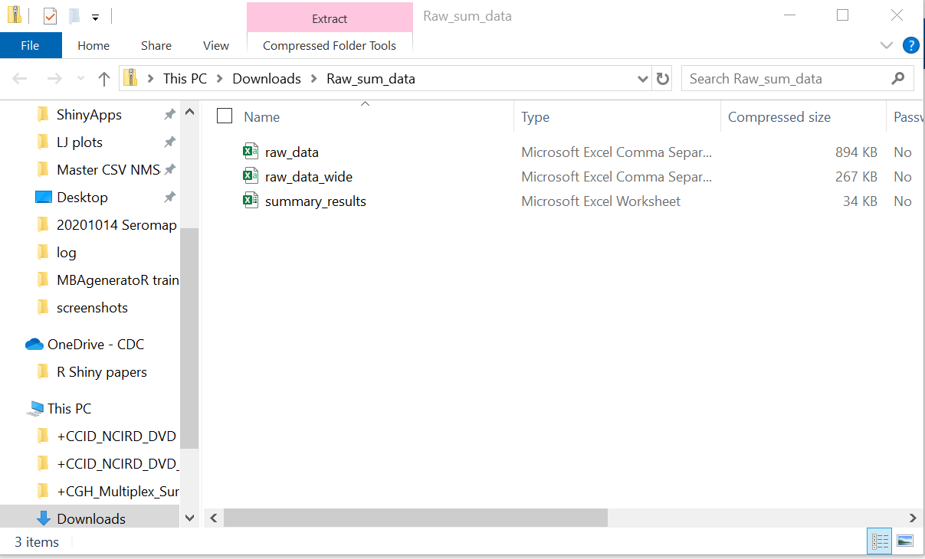
Merged datasets and bead count QC summary tables

Slide 62
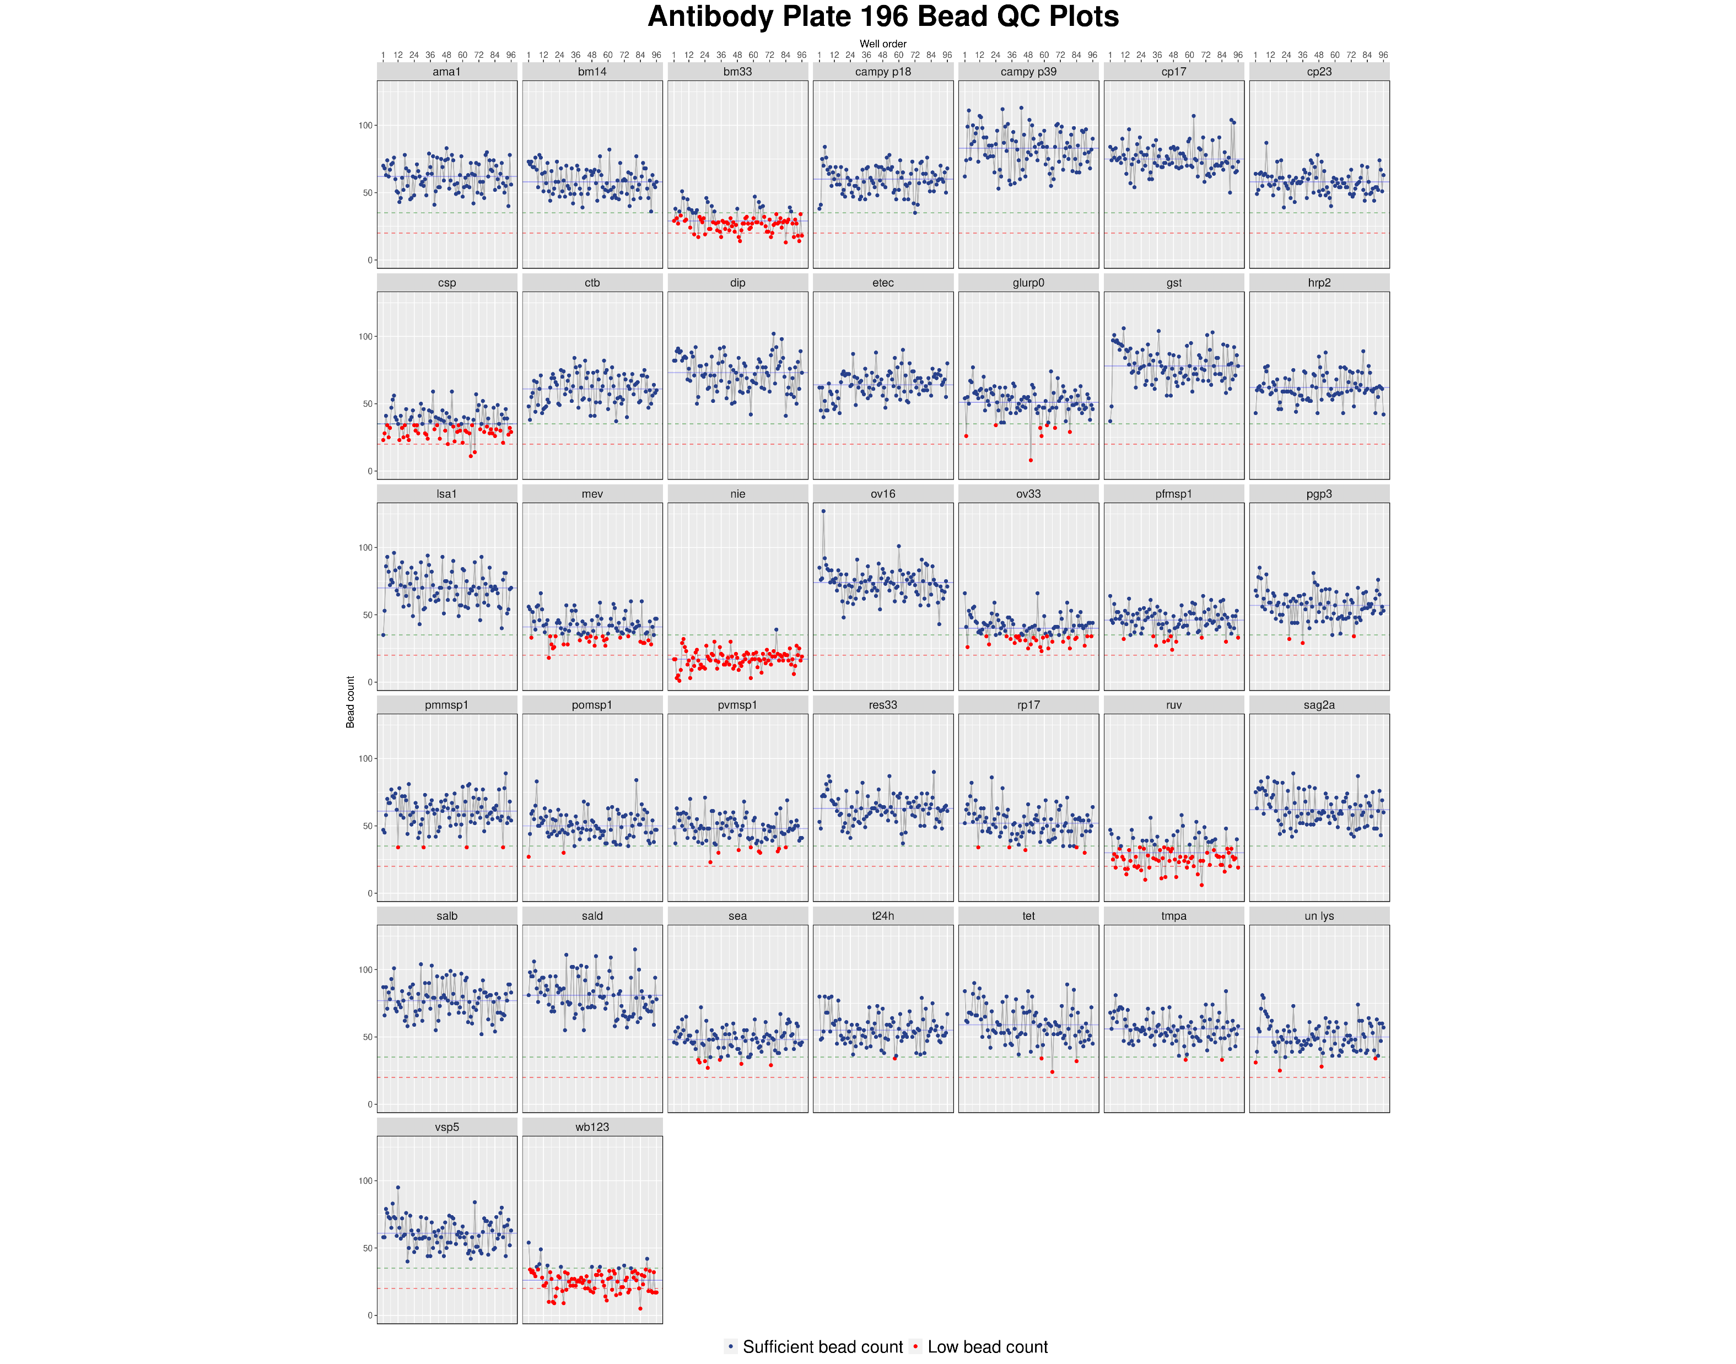
Bead count fluctuation plots
One plot for each plate with facets for every antigen/antibody

Slide 63
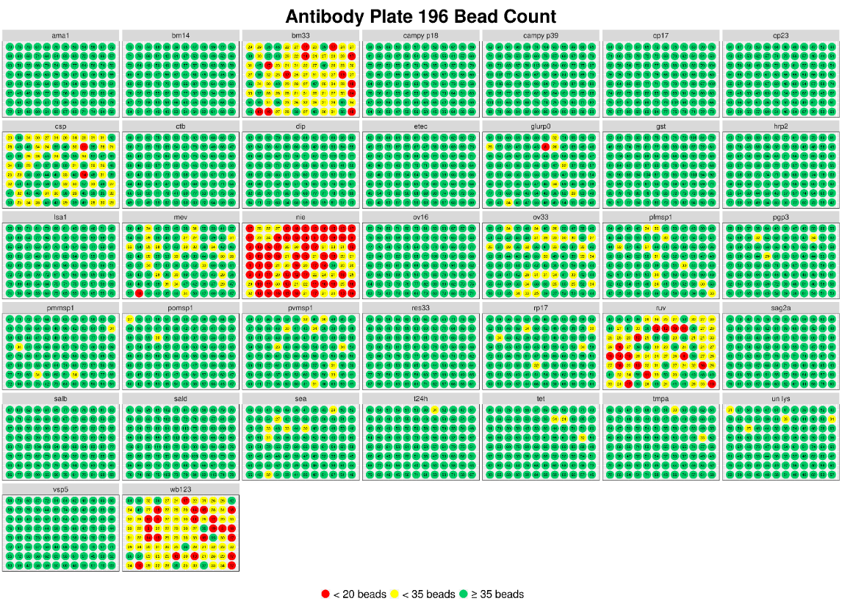
Bead count 96-well plate plots
One plot for each plate with facets for every antigen/antibody

Slide 64
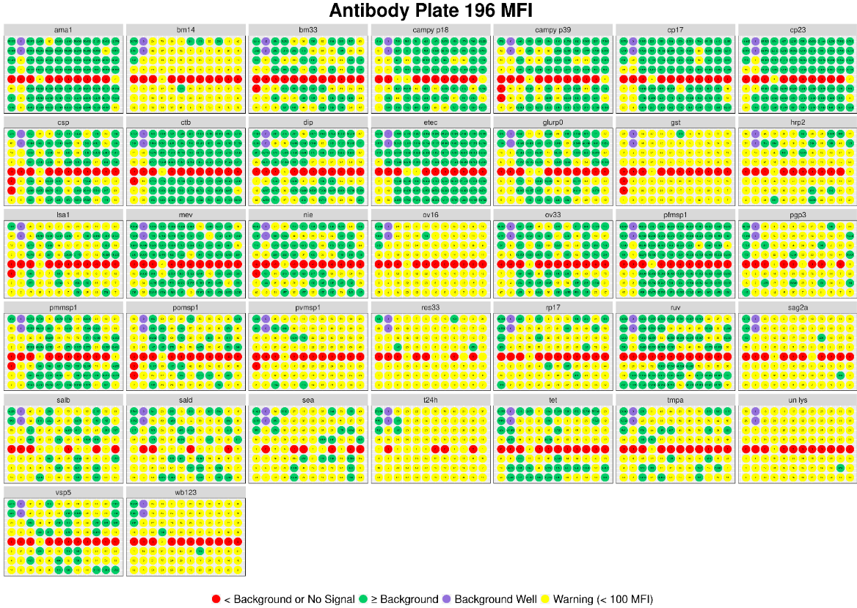
MFI 96-well plate plots
One plot for each plate with facets for every antigen/antibody

Slide 65
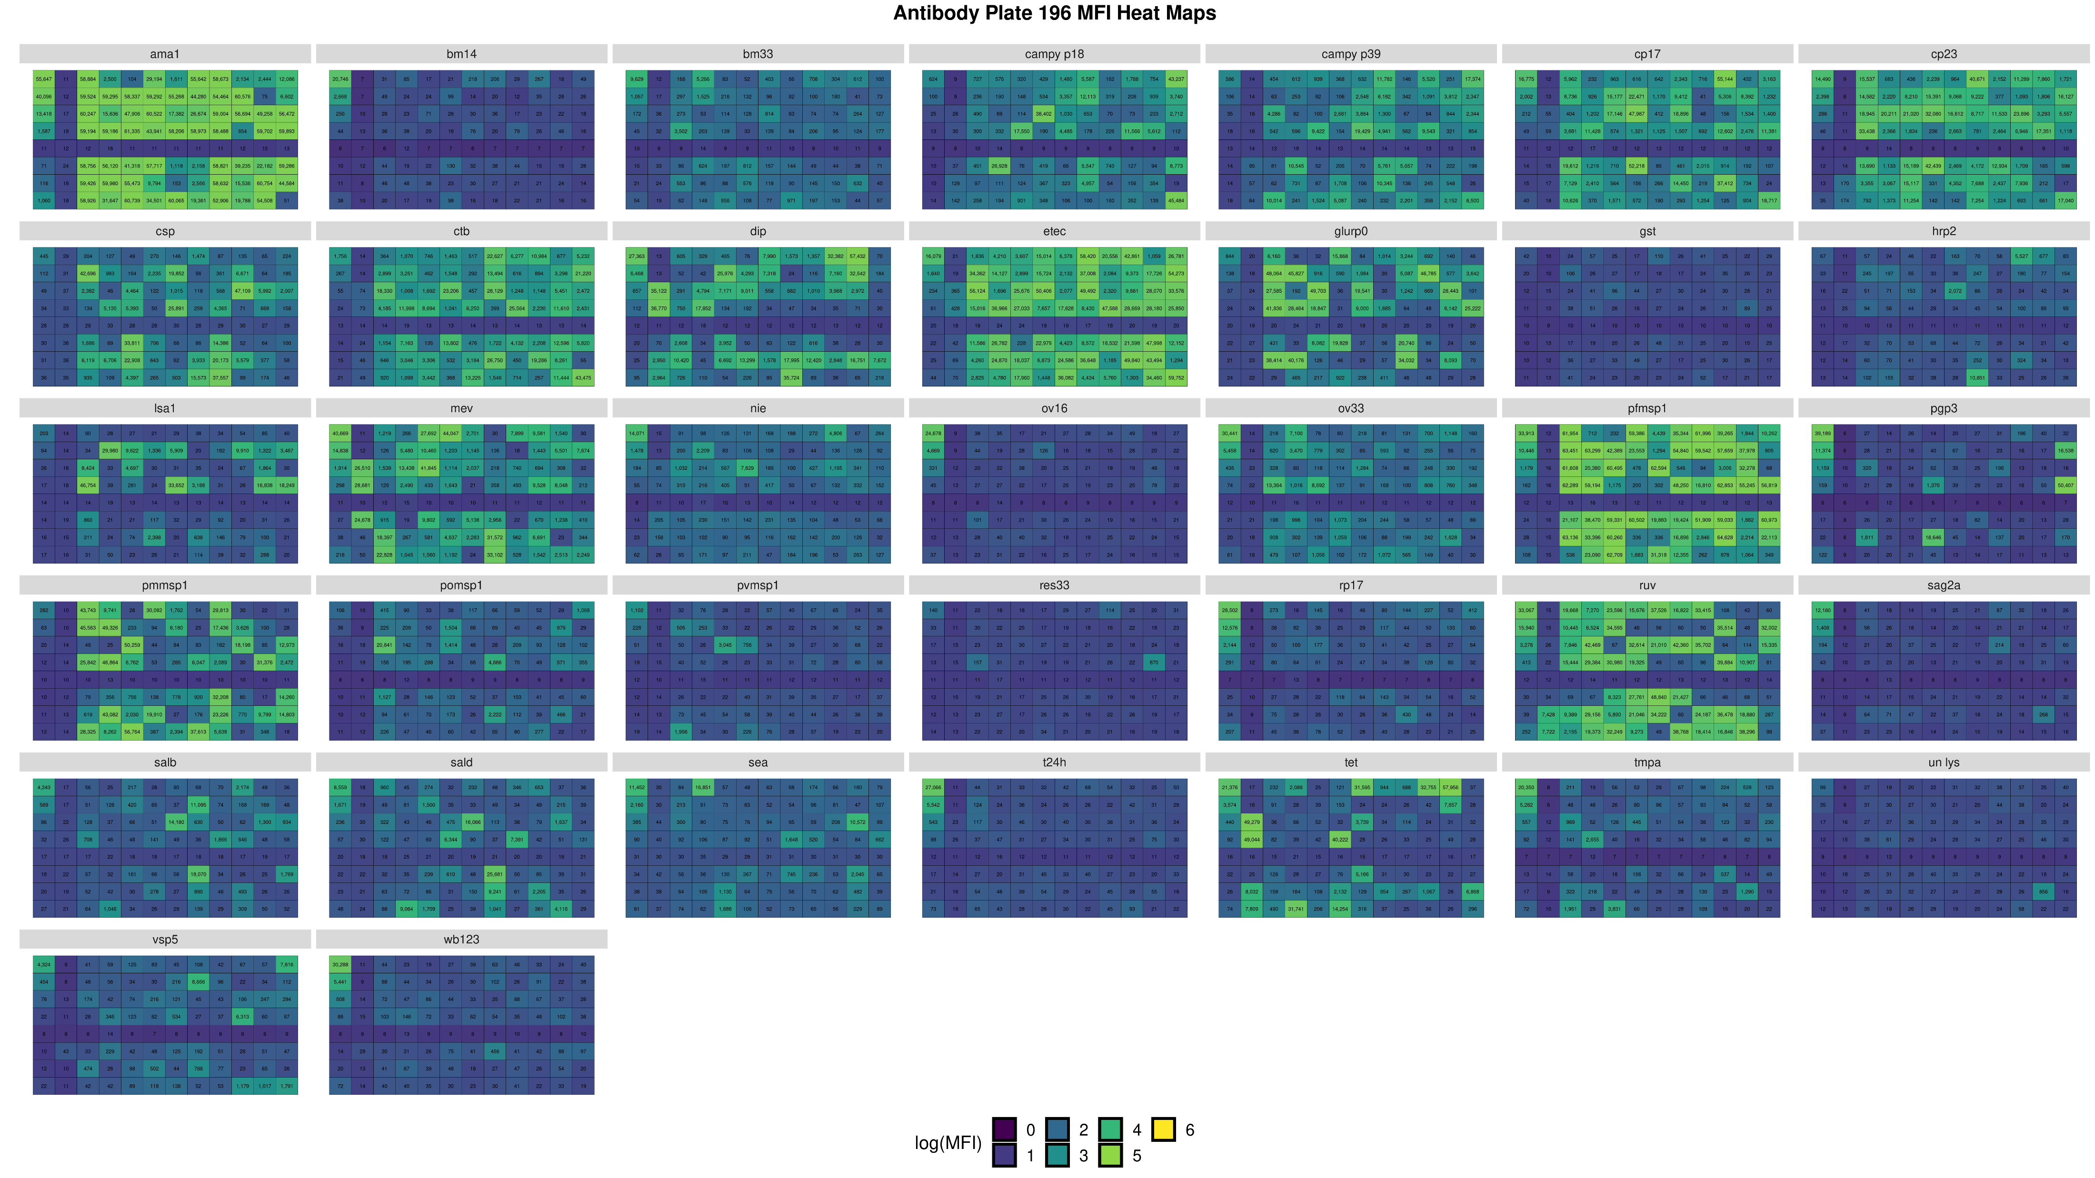
Log(MFI) 96-well heat maps
One plot for each plate with facets for every antigen/antibody

Slide 66
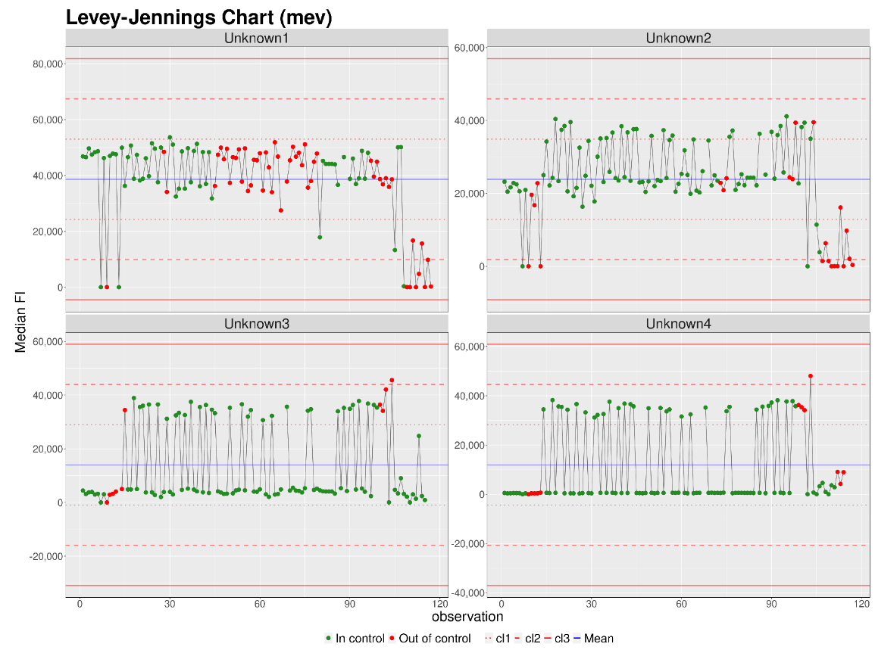
Control Process charts
One plot for each antigen/antibody with facets for every control

Slide 67
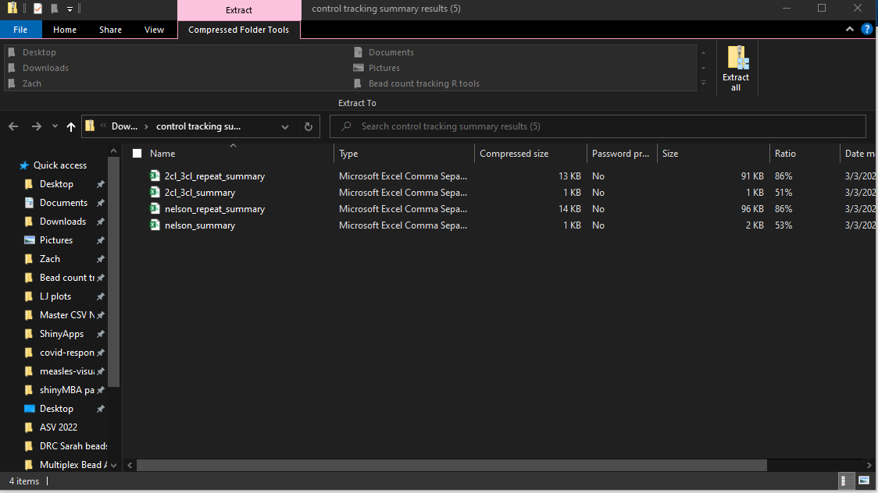
Levey-Jennings summary tables
Contains both Nelson rules and 2CL-3CL results

